Slide 1
The
Standard
Template
Library
...
Written by Rachel J. Morris, last updated 1/19/17

Slide 2
Topics:
Coming up with algorithms to search a linear array
Comparison of efficiency

Slide 3
Searching
Let’s say that we have an array of sorted data:
0
A
1
C
2
E
3
G
4
I
5
J
Index
Value
What kind of algorithm can we come up with to
(a) see if that item is in the array, and
(b) return the index (position) where that item is in the array.

Slide 4
Searching
Let’s say that we have an array of sorted data:
0
A
1
C
2
E
3
G
4
I
5
J
Index
Value
Sometimes, a good starting point is what seems most obvious – perhaps starting at the beginning, checking each item, as we traverse towards the end of the list.

Slide 5
Searching
Let’s say that we have an array of sorted data:
0
A
1
C
2
E
3
G
4
I
5
J
Index
Value
Sometimes, a good starting point is what seems most obvious – perhaps starting at the beginning, checking each item, as we traverse towards the end of the list.

Slide 6
Searching
Let’s say that we have an array of sorted data:
0
A
1
C
2
E
3
G
4
I
5
J
Index
Value
Algorithm: Find “I”

Slide 7
Searching
Let’s say that we have an array of sorted data:
0
A
1
C
2
E
3
G
4
I
5
J
Index
Value
Algorithm: Find “I”
Is “I” at position 0? No, that’s “A”.

Slide 8
Searching
Let’s say that we have an array of sorted data:
0
A
1
C
2
E
3
G
4
I
5
J
Index
Value
Algorithm: Find “I”
Is “I” at position 0? No, that’s “A”.
Is “I” at position 1? No, that’s “C”.

Slide 9
Searching
Let’s say that we have an array of sorted data:
0
A
1
C
2
E
3
G
4
I
5
J
Index
Value
Algorithm: Find “I”
Is “I” at position 0? No, that’s “A”.
Is “I” at position 1? No, that’s “C”.
Is “I” at position 2? No, that’s “E”.

Slide 10
Searching
Let’s say that we have an array of sorted data:
0
A
1
C
2
E
3
G
4
I
5
J
Index
Value
Algorithm: Find “I”
Is “I” at position 0? No, that’s “A”.
Is “I” at position 1? No, that’s “C”.
Is “I” at position 2? No, that’s “E”.
Is “I” at position 3? No, that’s “G”.

Slide 11
Searching
Let’s say that we have an array of sorted data:
0
A
1
C
2
E
3
G
4
I
5
J
Index
Value
Algorithm: Find “I”
Is “I” at position 0? No, that’s “A”.
Is “I” at position 1? No, that’s “C”.
Is “I” at position 2? No, that’s “E”.
Is “I” at position 3? No, that’s “G”.
Is “I” at position 4? Yes! Found at position 4.
5 comparisons performed to find “I”.

Slide 12
Searching
Let’s say that we have an array of sorted data:
Algorithm: Find “I”
Is “I” at position 0? No, that’s “A”.
Is “I” at position 1? No, that’s “C”.
Is “I” at position 2? No, that’s “E”.
Is “I” at position 3? No, that’s “G”.
Is “I” at position 4? Yes! Found at position 4.
5 comparisons performed to find “I”.
0
A
1
C
2
E
3
G
4
I
5
J
Index
Value
For a small array, 5 comparisons isn’t a big deal.
However, if this array were much bigger, a search could take a long time!

Slide 13
Searching
0
A
1
C
2
E
3
G
4
I
5
J
Index
Value
Also, this array contains sorted data, so we could write an algorithm that performs more efficiently than just starting at the beginning and moving forward!

Slide 14
Searching
0
A
1
C
2
E
3
G
4
I
5
J
Index
Value
As a simple example, the next-obvious search algorithm might be to either move from beginning-to-end, or end-to-beginning, based on whether our search term is closer to the minimum value (at 0),
or the maximum value (at 5).

Slide 15
Searching
0
A
1
C
2
E
3
G
4
I
5
J
Index
Value
Algorithm: Find “I”
Is “I” closer to “A” at 0, or “J” at 5? “J”.
Search from end to begin!

Slide 16
Searching
0
A
1
C
2
E
3
G
4
I
5
J
Index
Value
Algorithm: Find “I”
Is “I” closer to “A” at 0, or “J” at 5? “J”.
Search from end to begin!
Is “I” at position 5? No, that’s, “J”.

Slide 17
Searching
0
A
1
C
2
E
3
G
4
I
5
J
Index
Value
Algorithm: Find “I”
Is “I” closer to “A” at 0, or “J” at 5? “J”.
Search from end to begin!
Is “I” at position 4? Yes, it is at position 4!
2 comparisons performed to find “I”.

Slide 18
Searching
Algorithm: Find “I”
Is “I” at position 0? No, that’s “A”.
Is “I” at position 1? No, that’s “C”.
Is “I” at position 2? No, that’s “E”.
Is “I” at position 3? No, that’s “G”.
Is “I” at position 4? Yes! Found at position 4.
5 comparisons performed to find “I”.
So when we have sorted data, we can come up with something more intelligent to try to find our search item faster!
Algorithm: Find “I”
Is “I” closer to “A” at 0, or “J” at 5? “J”.
Search from end to begin!
Is “I” at position 4? Yes, it is at position 4!
2 comparisons performed to find “I”.

Slide 19
Searching
Algorithm: Find “I”
Is “I” at position 0? No, that’s “A”.
Is “I” at position 1? No, that’s “C”.
Is “I” at position 2? No, that’s “E”.
Is “I” at position 3? No, that’s “G”.
Is “I” at position 4? Yes! Found at position 4.
5 comparisons performed to find “I”.
Algorithm: Find “I”
Is “I” closer to “A” at 0, or “J” at 5? “J”.
Search from end to begin!
Is “I” at position 4? Yes, it is at position 4!
2 comparisons performed to find “I”.
The amount of comparisons performed is how we can tell which one is more efficient than the other. Another way to think of it is, how many times did we go through one cycle of the loop?

Slide 20
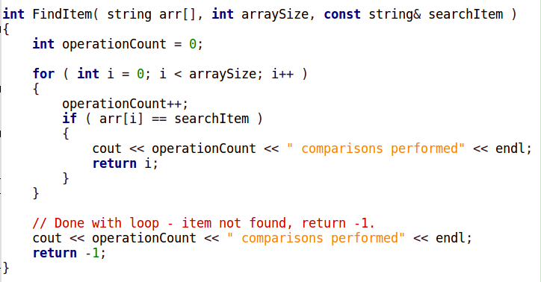
Searching
0
A
1
C
2
E
3
G
4
I
5
J
We can step through this search algorithm by using our IDE’s debugging tools (like break points) to see it in action!

